Slide 1


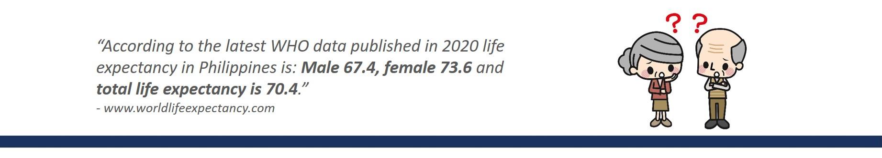


Slide 2






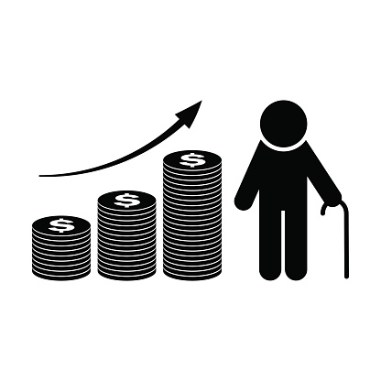


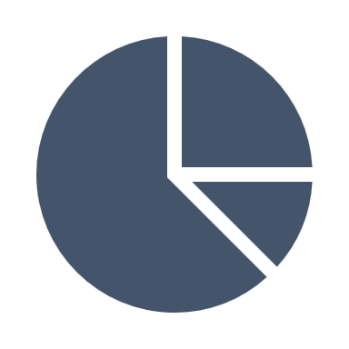


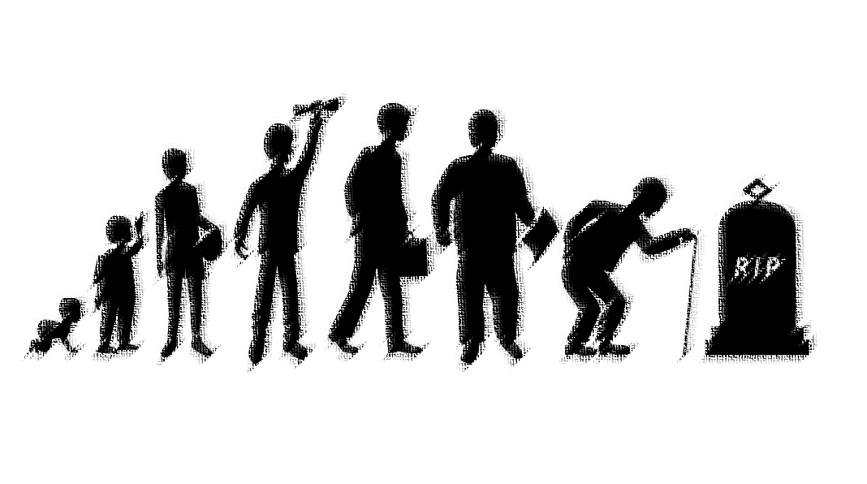
3 MAJOR STAGES OF LIFE
0
20
60
100
EDUCATION WORKING STAGE RETIREMENT
(no income) (no income)
Remember: INTEGRITY. DISCIPLINE. HUMILITY
“According to the W.H.O. data published in 2020,
life expectancy in the Philippines is: male 67.4, female 73.6 and total life expectancy is 70.4
- www.worldlifeexpectancy.com

Slide 3





1. Coronary Heart Disease
2. Influenza and Pneumonia
3. Stroke
4. Kidney Disease
5. Lung Disease
6. Hypertension
7. Diabetes Mellitus
8. Tuberculosis
9. Breast Cancer
10. Prostate Cancer
10 Leading
Causes of Death
In GOAL SETTING,
be
Specific | Measurable | Attainable | Realistic | Time-bounded

